Slide 1
STAT115 Lab 1
31 January/2 February 2017

Slide 2
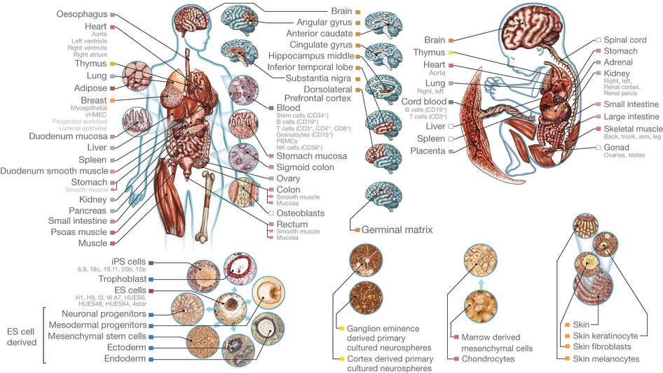
From NIH Roadmap

Slide 3
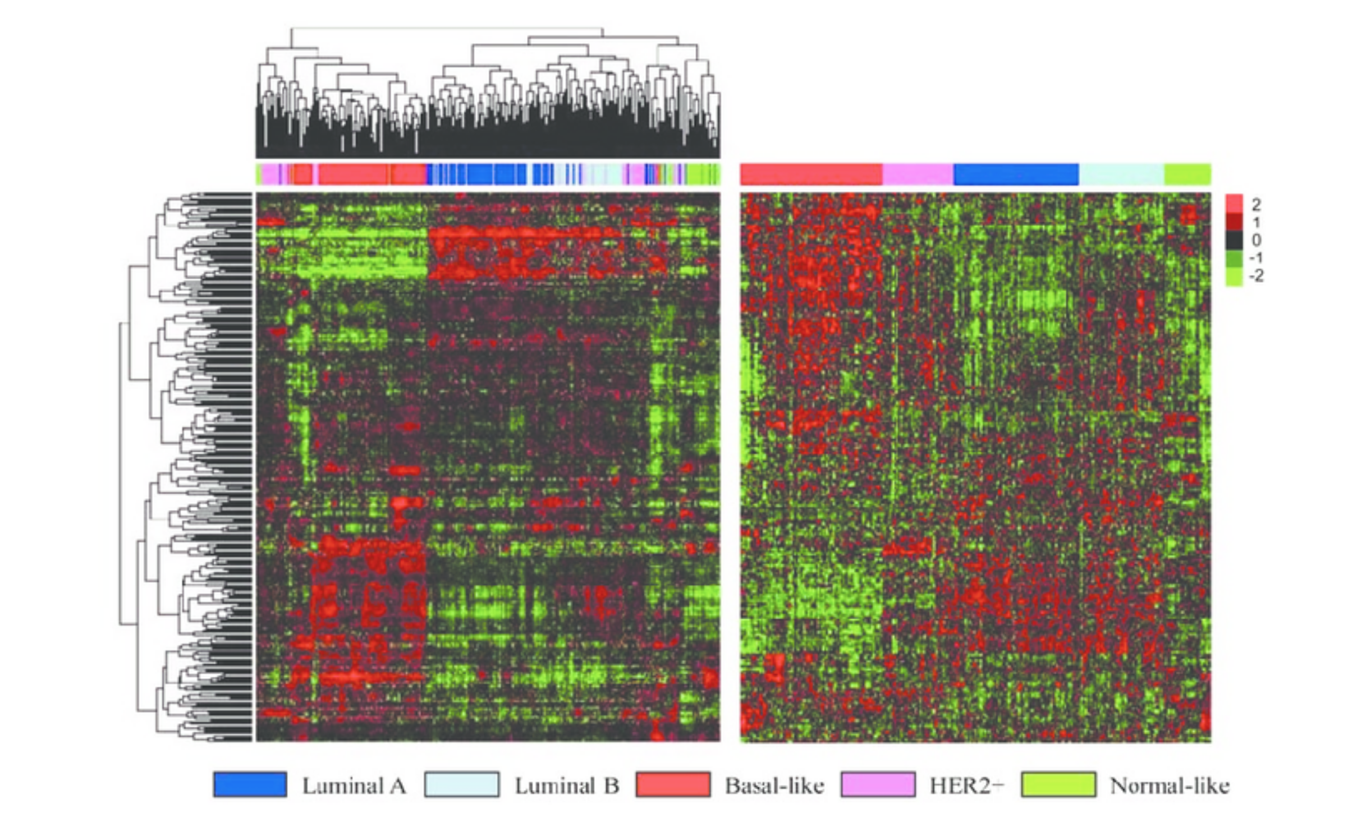

Slide 4
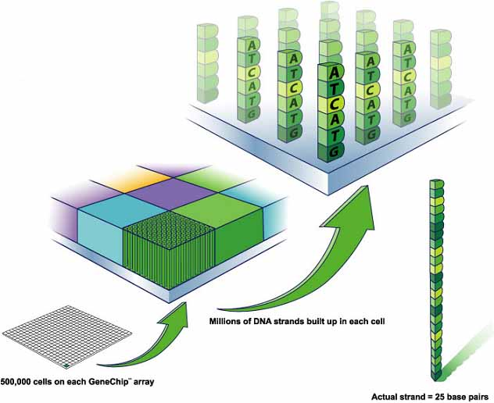
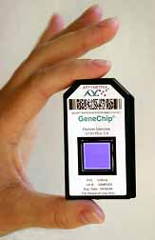

Slide 5
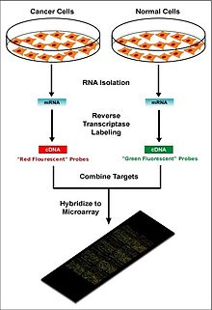
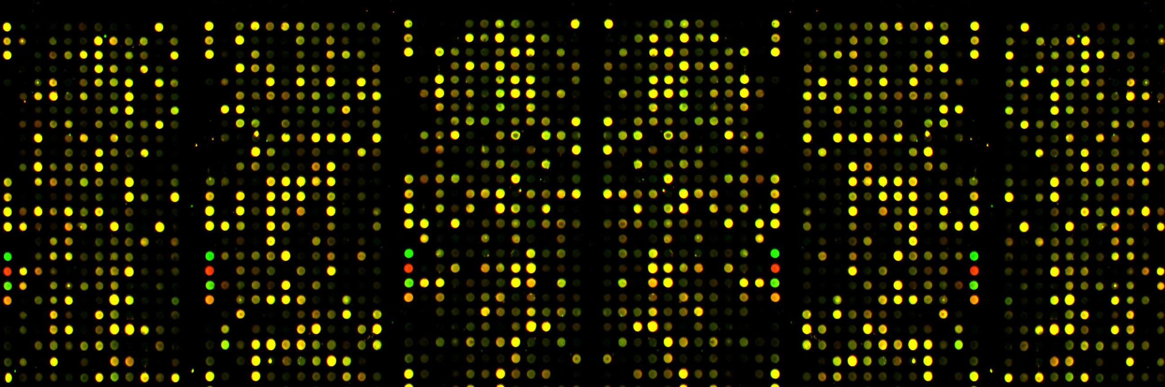

Slide 6
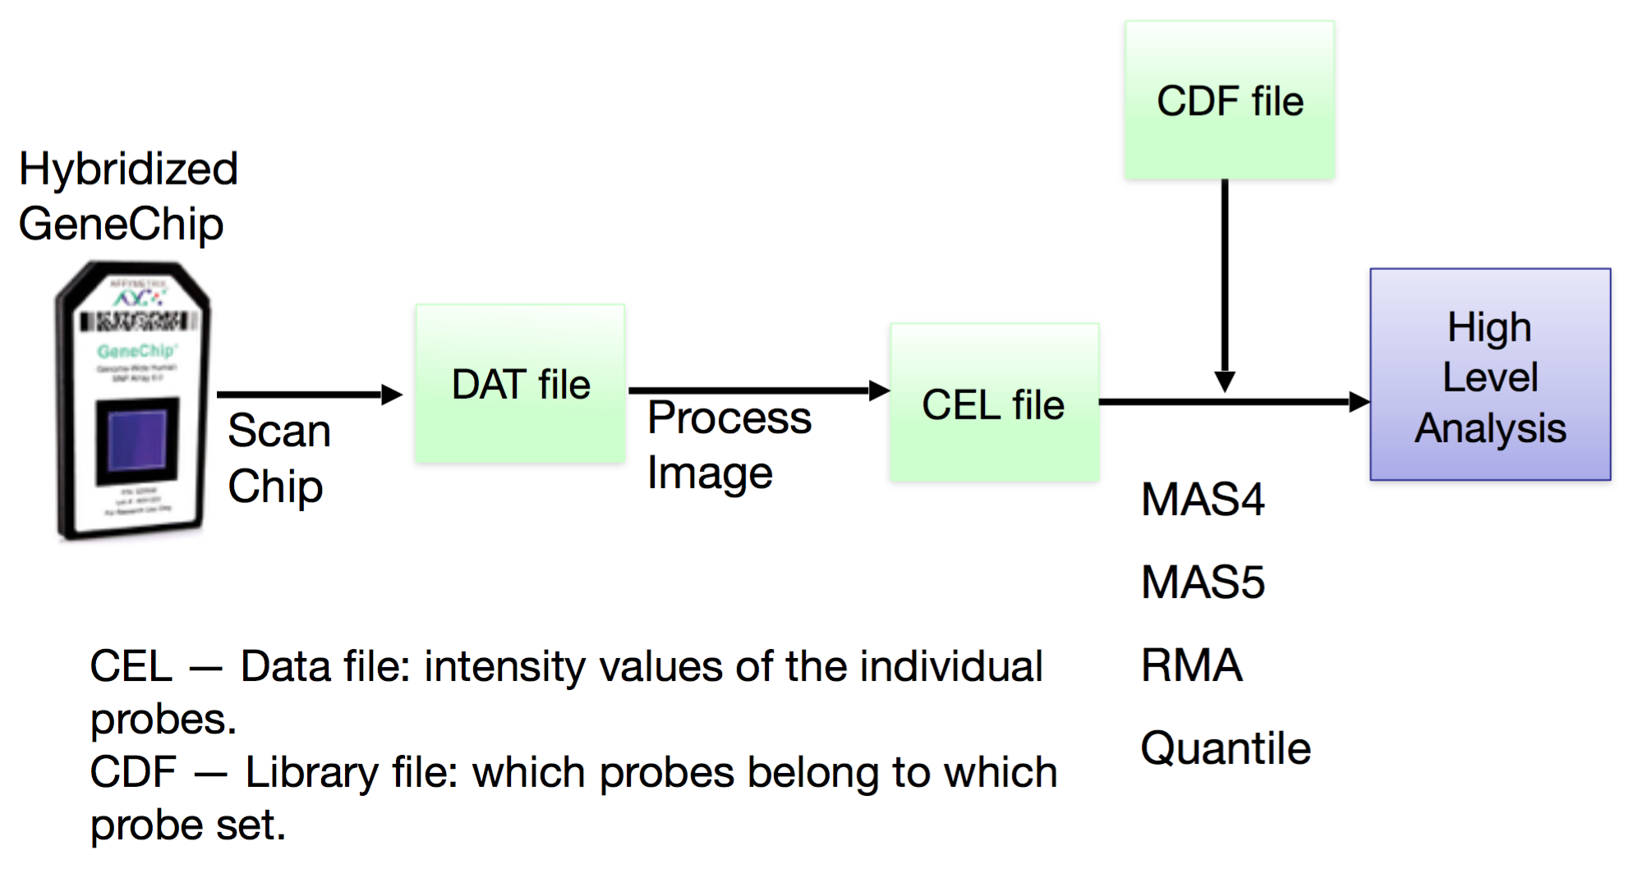

Slide 7
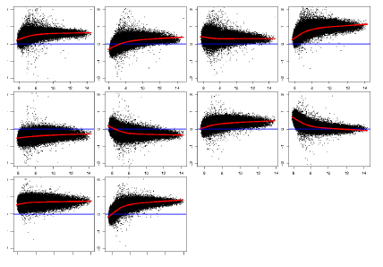
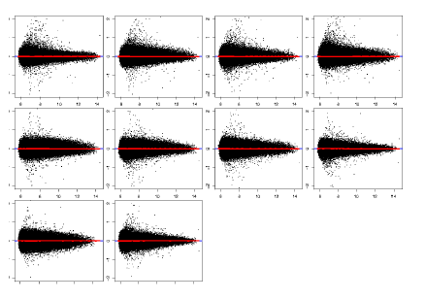
MA Plots
M
A

Slide 8
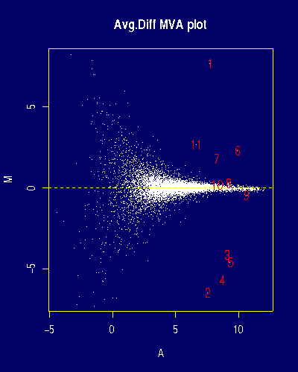
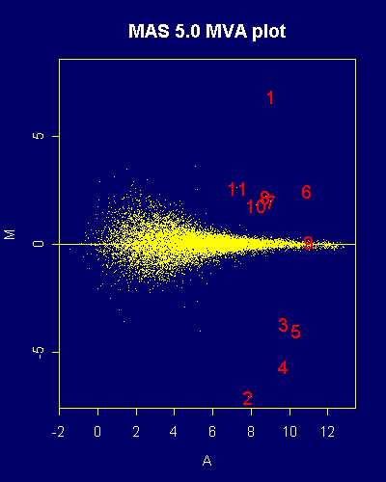
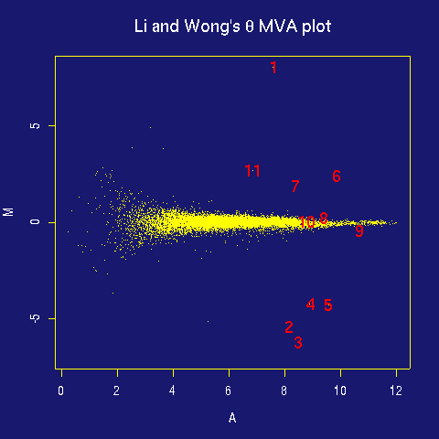
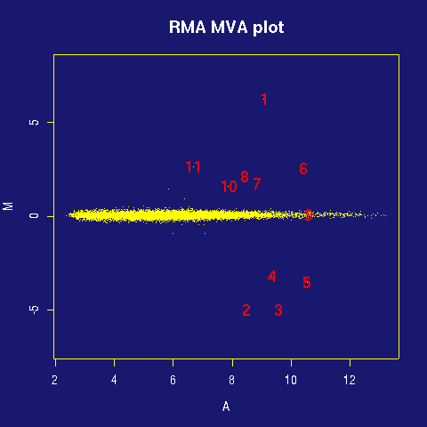
MAS4
MAS 5
dChip
RMA

Slide 9
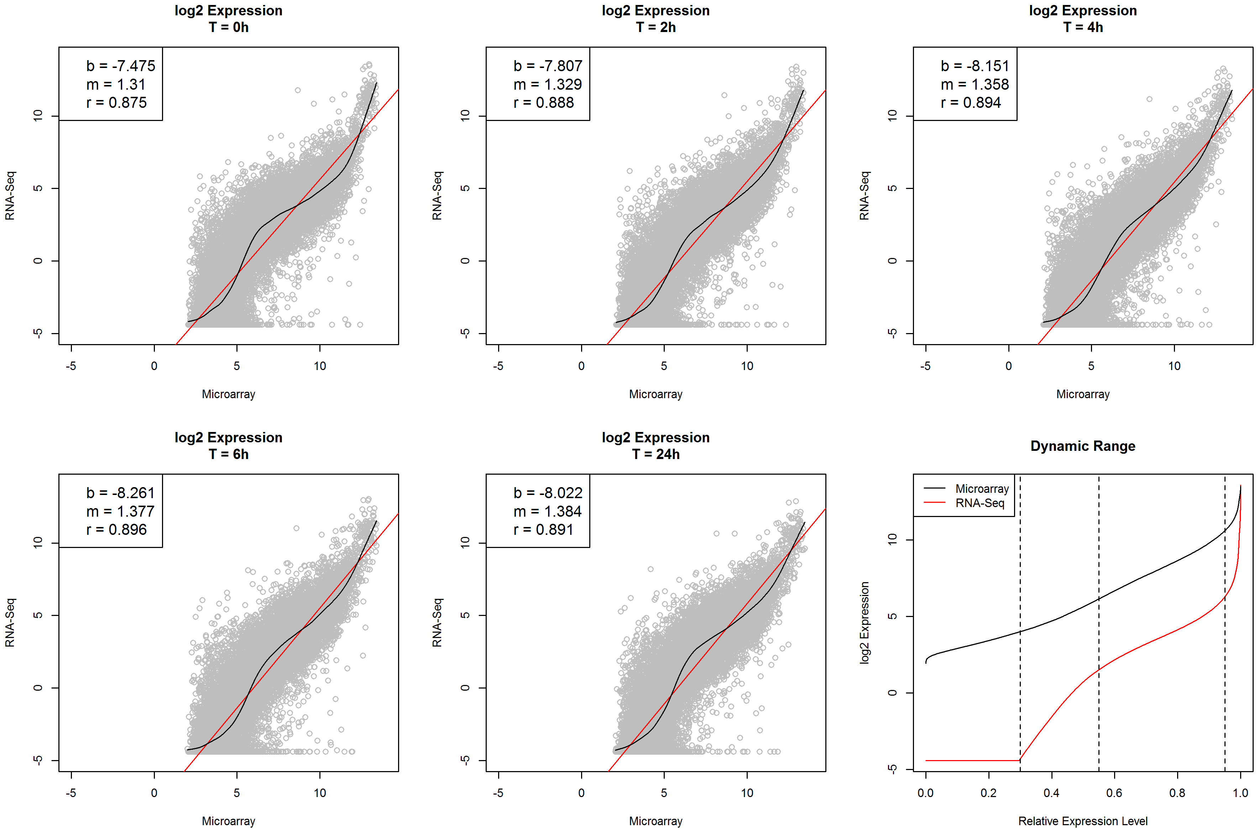
RNA-Seq vs. Microarray
http://journals.plos.org/plosone/article?id=10.1371/journal.pone.0078644

Slide 10
RStudio
https://www.rstudio.com/products/rstudio/download/

Slide 11
Github
https://github.com/
Create account
https://education.github.com/
Two years of free

